Slide 1

Predicting Customer Churn
Presented By: Max Glasser, Tungalagtuya Naran, Francesca Palik & Joel Wiseman
Notes:
Joel: Slide 1-3, 7-9
Max: 4-6
Tunga: 10 & 11
Francesca: 12-14

Slide 2

What is Customer Churn?
Customer churn rate (CCR) is the essential metric for tracking how many customers are leaving your firm. It is always expressed as a percentage. It also always covers a specific period of time. For example, “a 10% customer churn rate for the last quarter”.
Its important to remember that customer churn rate is the inverse of the customer retention rate. For example, if you have a churn rate of 10%, your retention rate is therefore 90%.
This matters because decision-makers looking at forecasting need to address customer churn to achieve their customer retention goals.

Slide 3
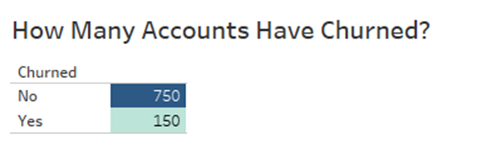
What about the Data Set?
A marketing agency has many customers who use their service to produce ads for customer websites. They've noticed that they have quite a bit of churn in clients. They randomly assign account managers but want to be more strategic by assigning their best account managers to the clients most at risk to churn. They have provided their historical client data, so that we can leverage to build a machine-learning model to quickly identify at-risk customers.
Key Data Points
Name: Name of the latest contact at Company
Age: Customer Age
Total Purchase: Total Ads Purchased
Account Manager: Binary 0=No manager, 1= Account manager assigned
Years: Total Years as a customer
Number of Websites Used: Number of websites that use the service.
Onboard Date: The date that the name of the latest contact was onboarded
Location: Client HQ Address
Company: Name of Client Company
Data Source: https://www.kaggle.com/datasets/hassanamin/customer-churn

Slide 4
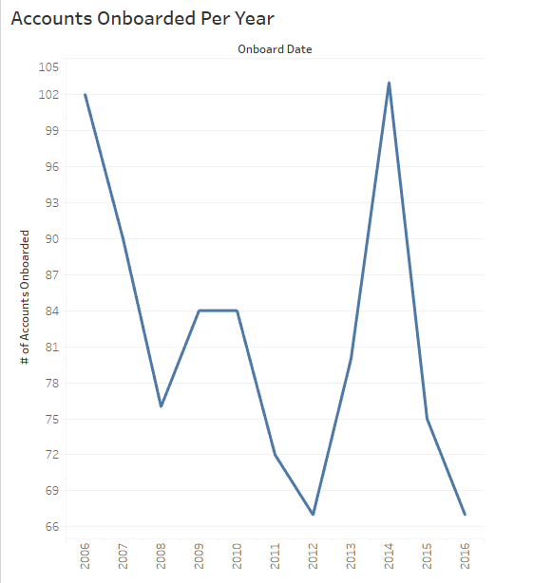
Data Overview
Notes:
Max

Slide 5
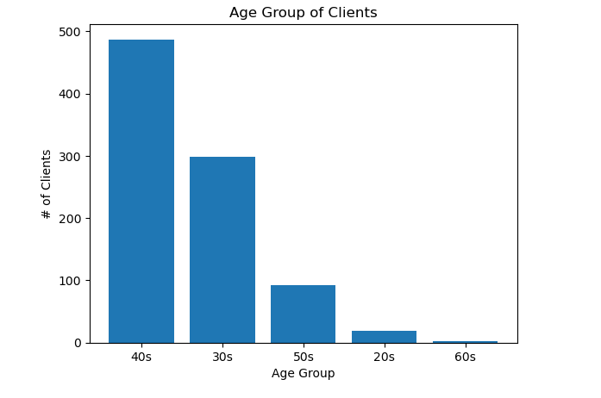
Data Overview

Slide 6
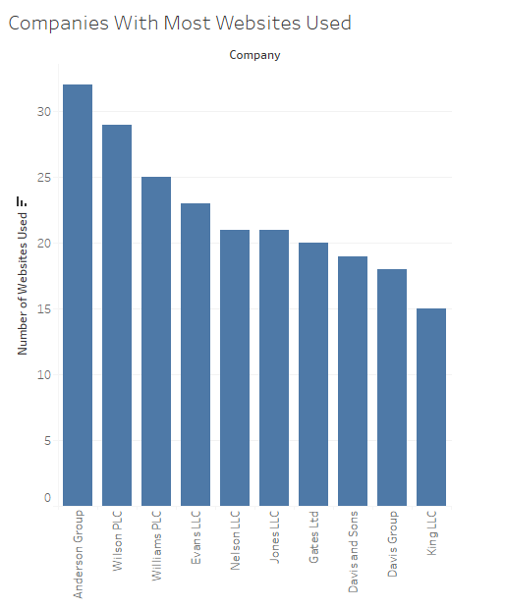
Data Overview

Slide 7
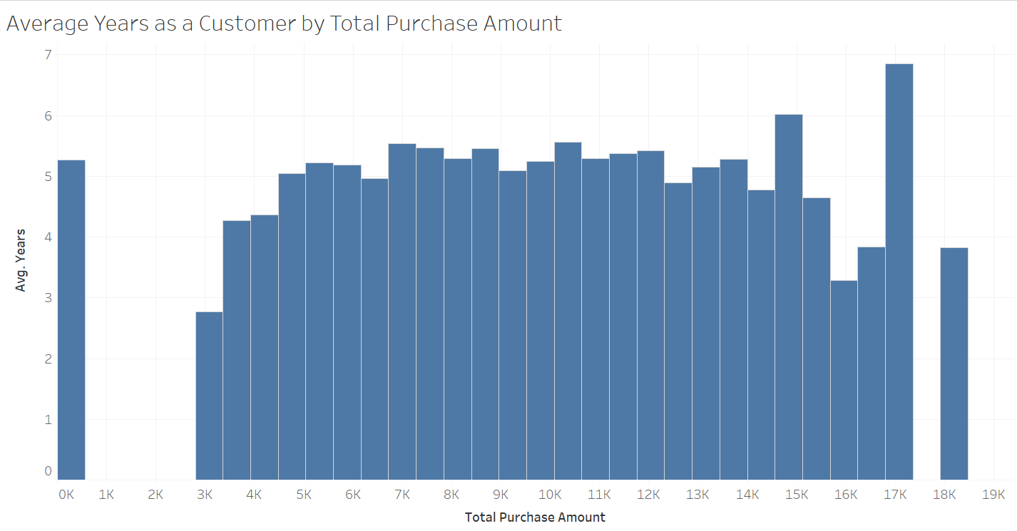
Data Overview

Slide 8
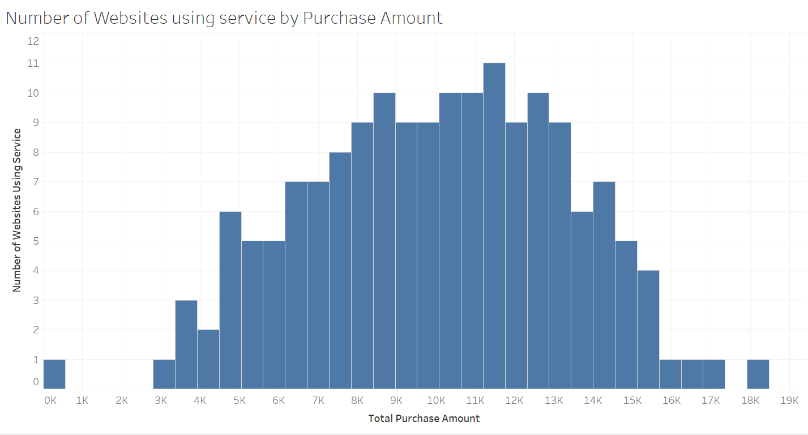
Data Overview

Slide 9
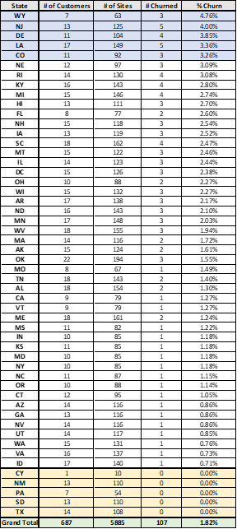
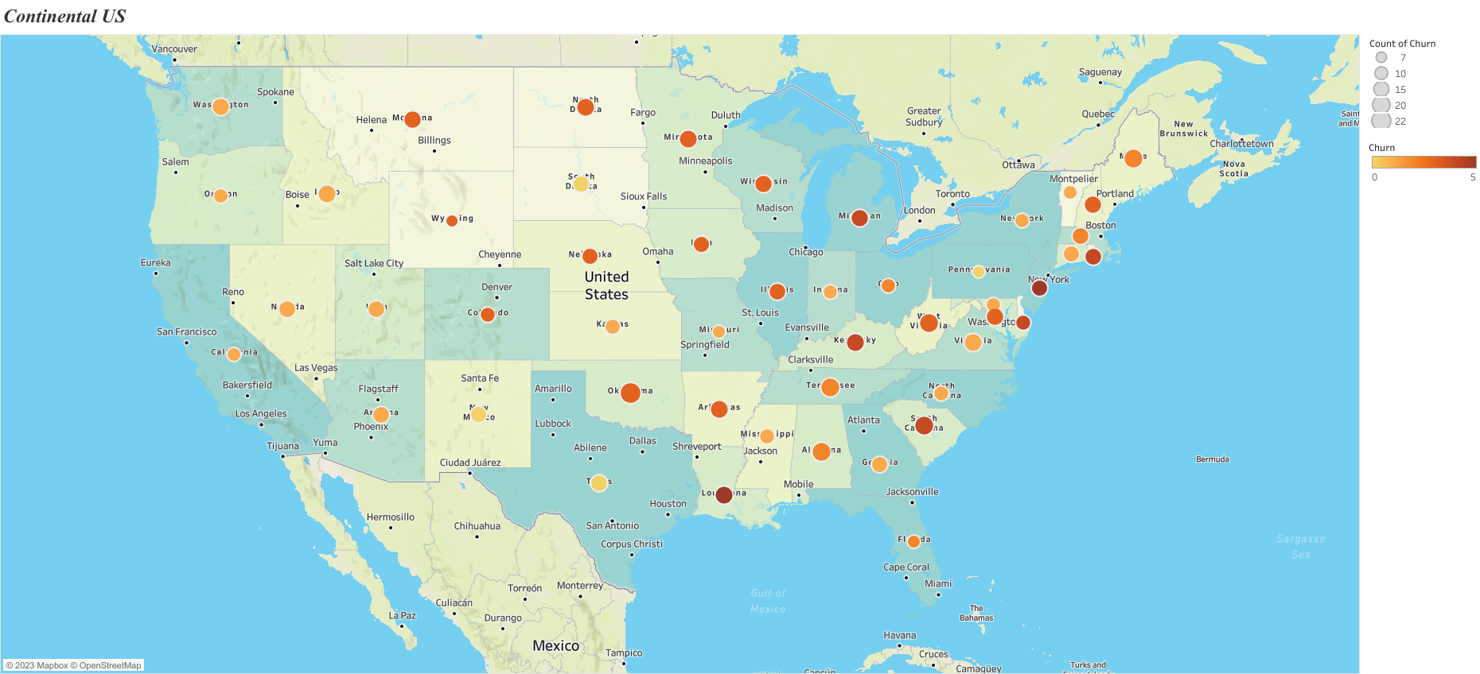
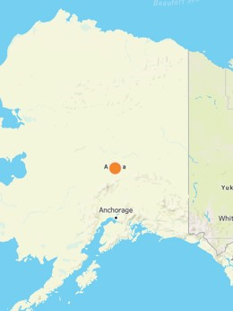
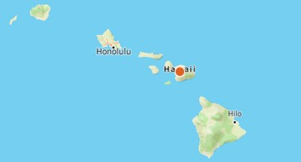
Data Overview

Slide 10
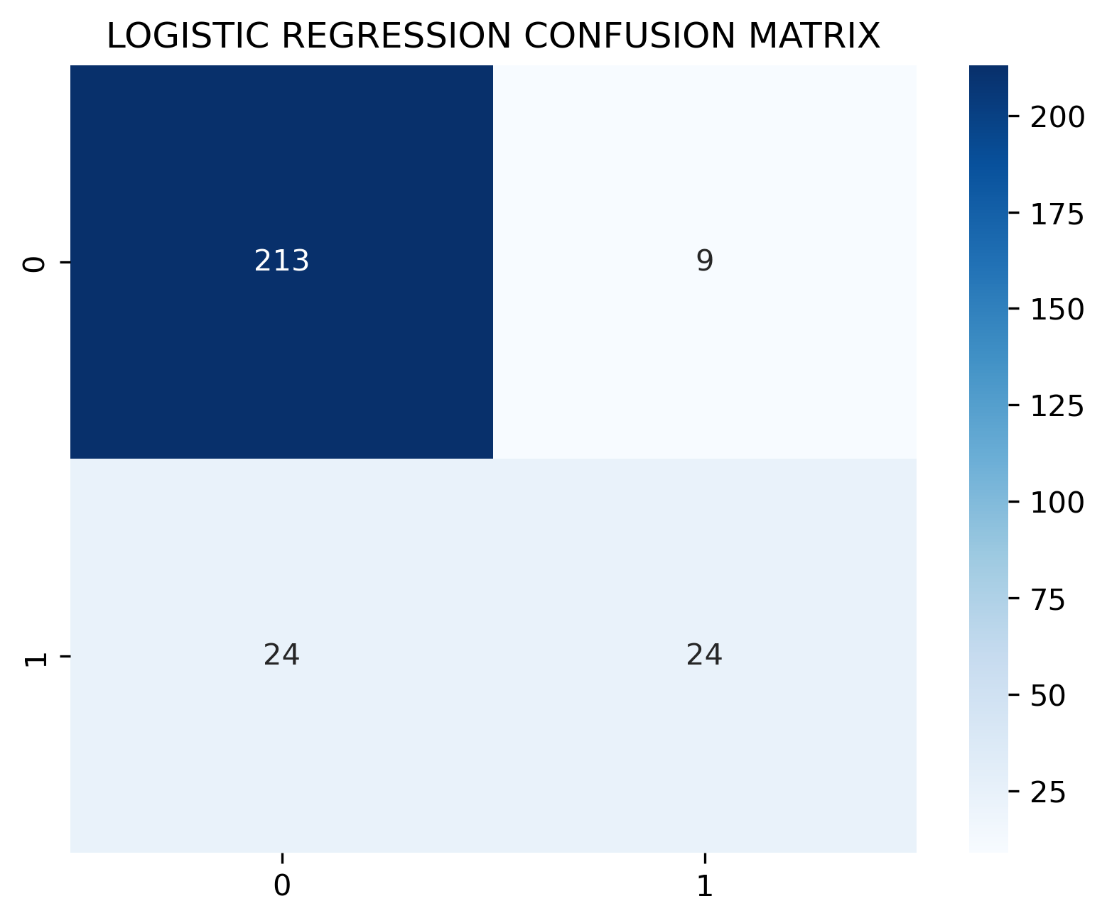
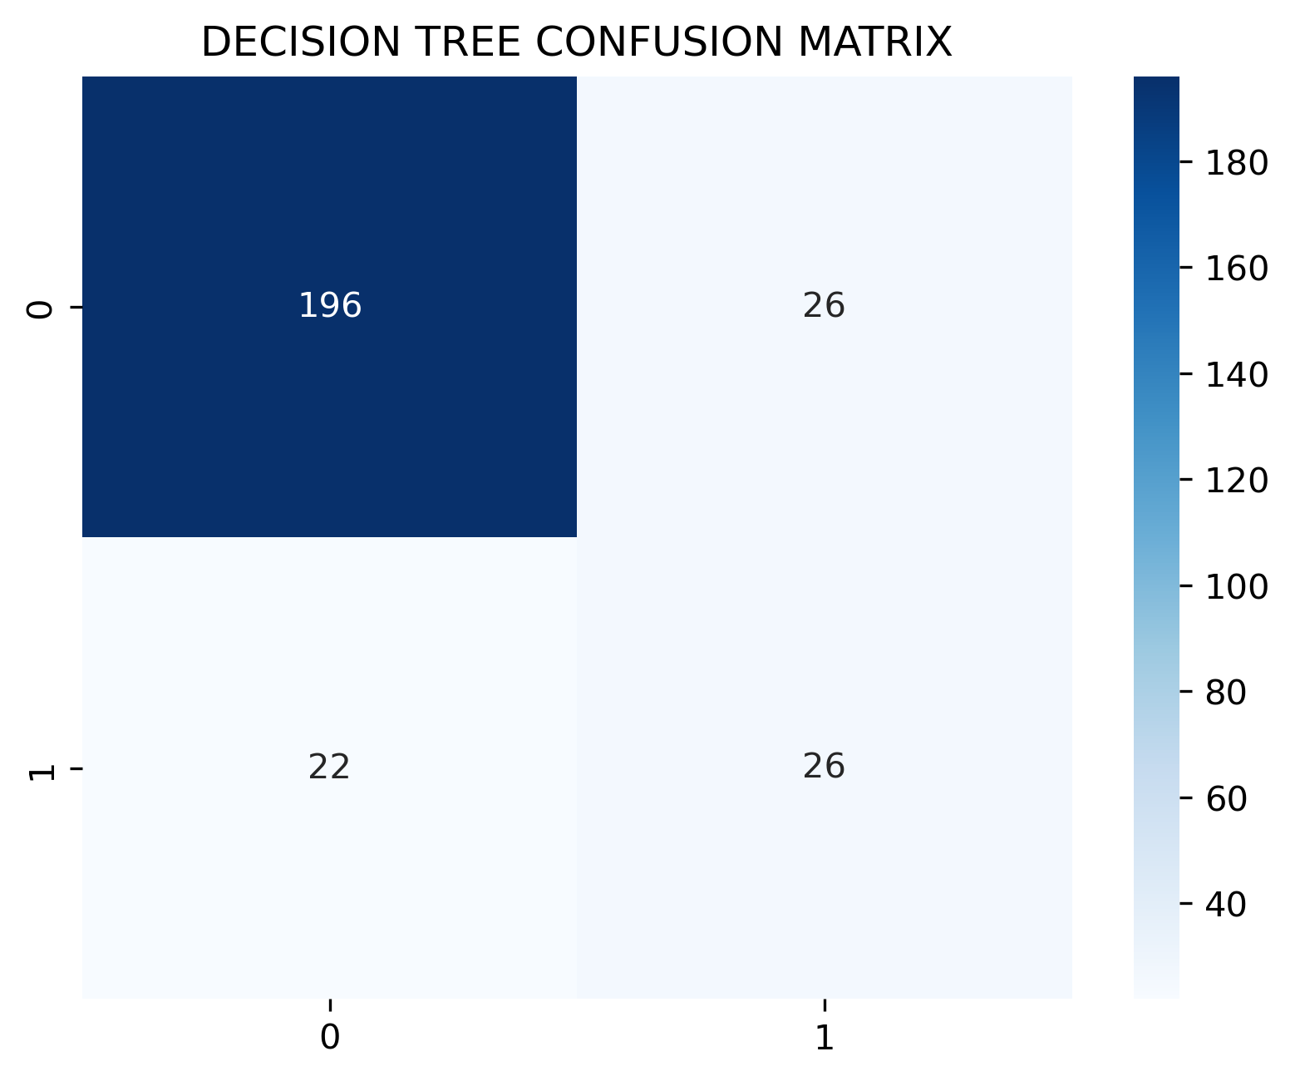
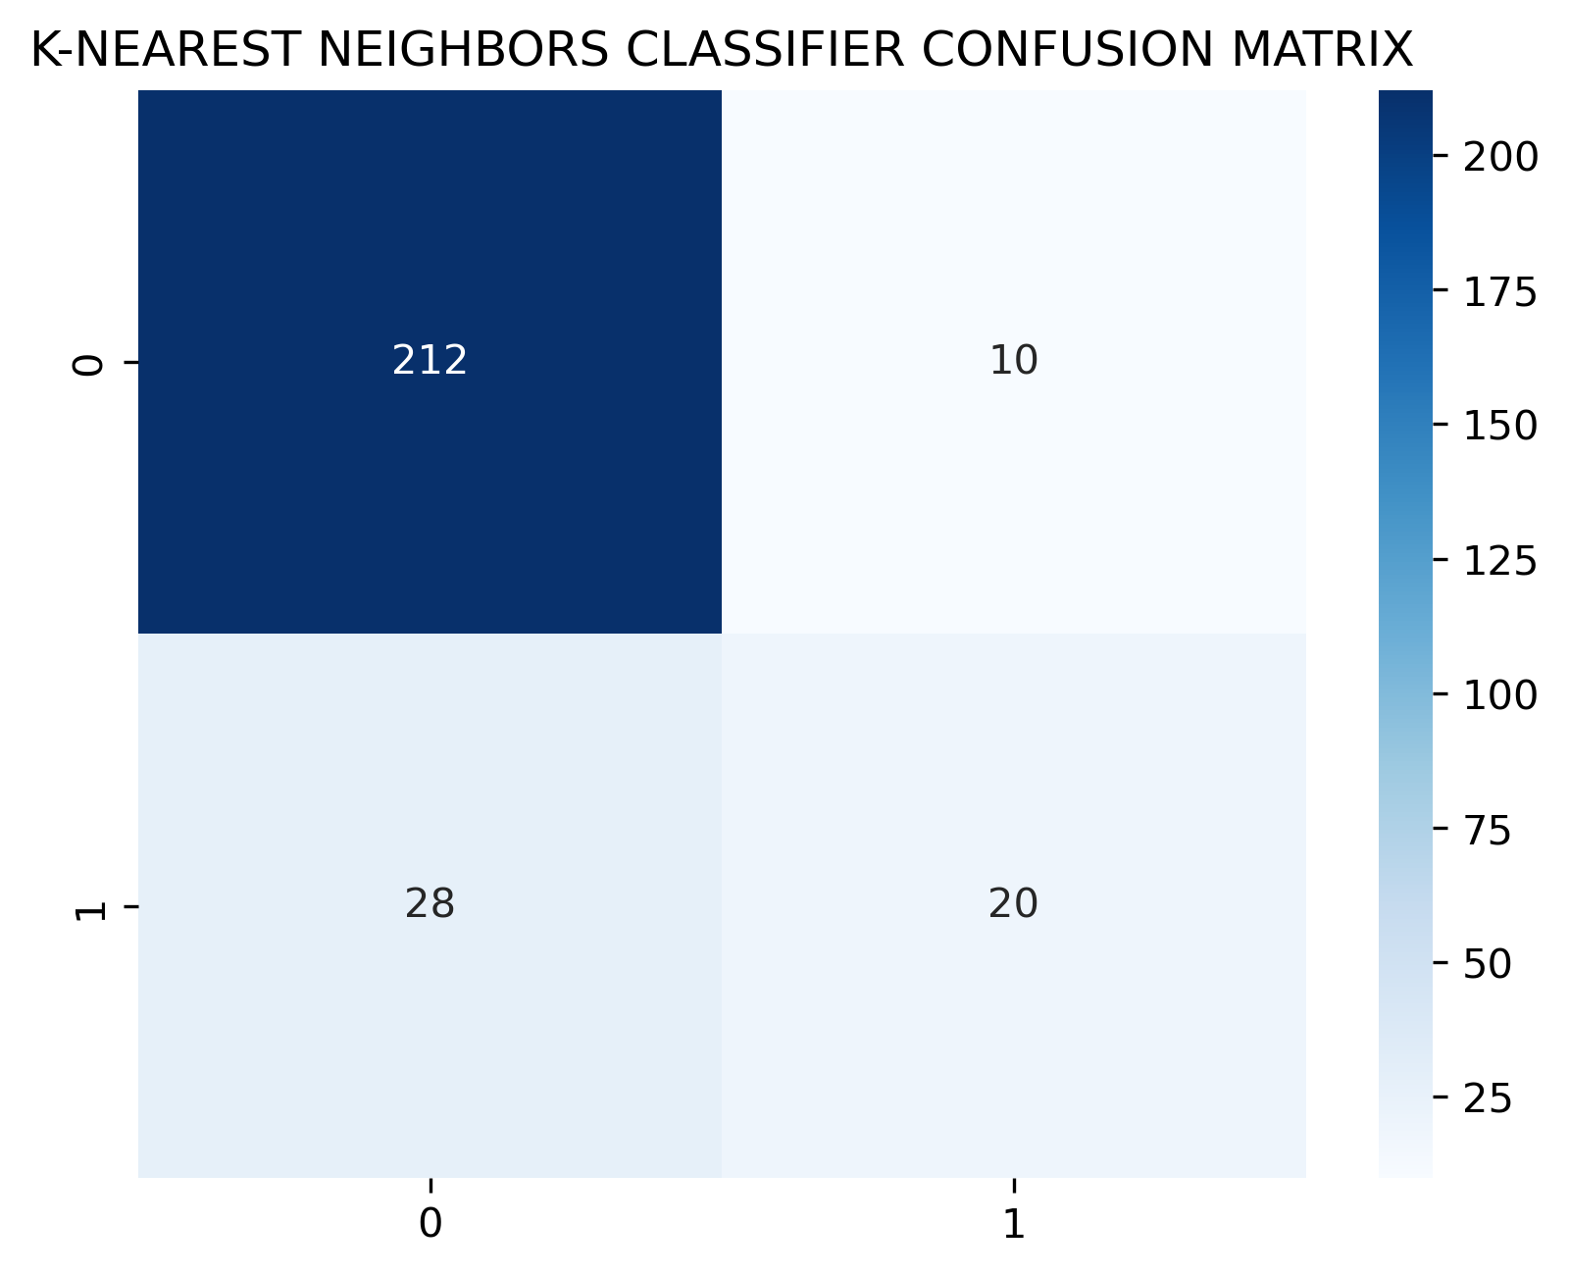
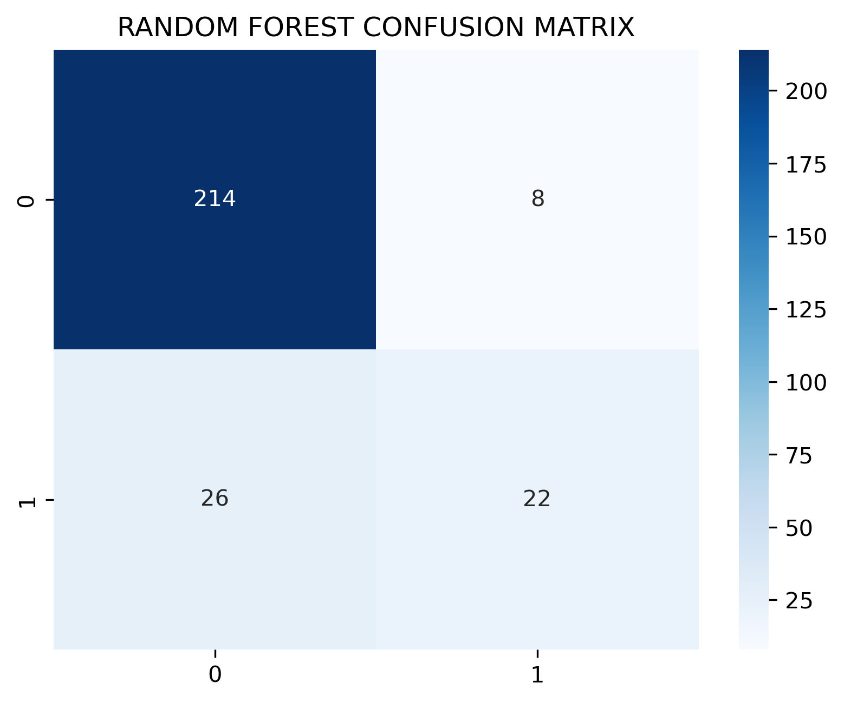
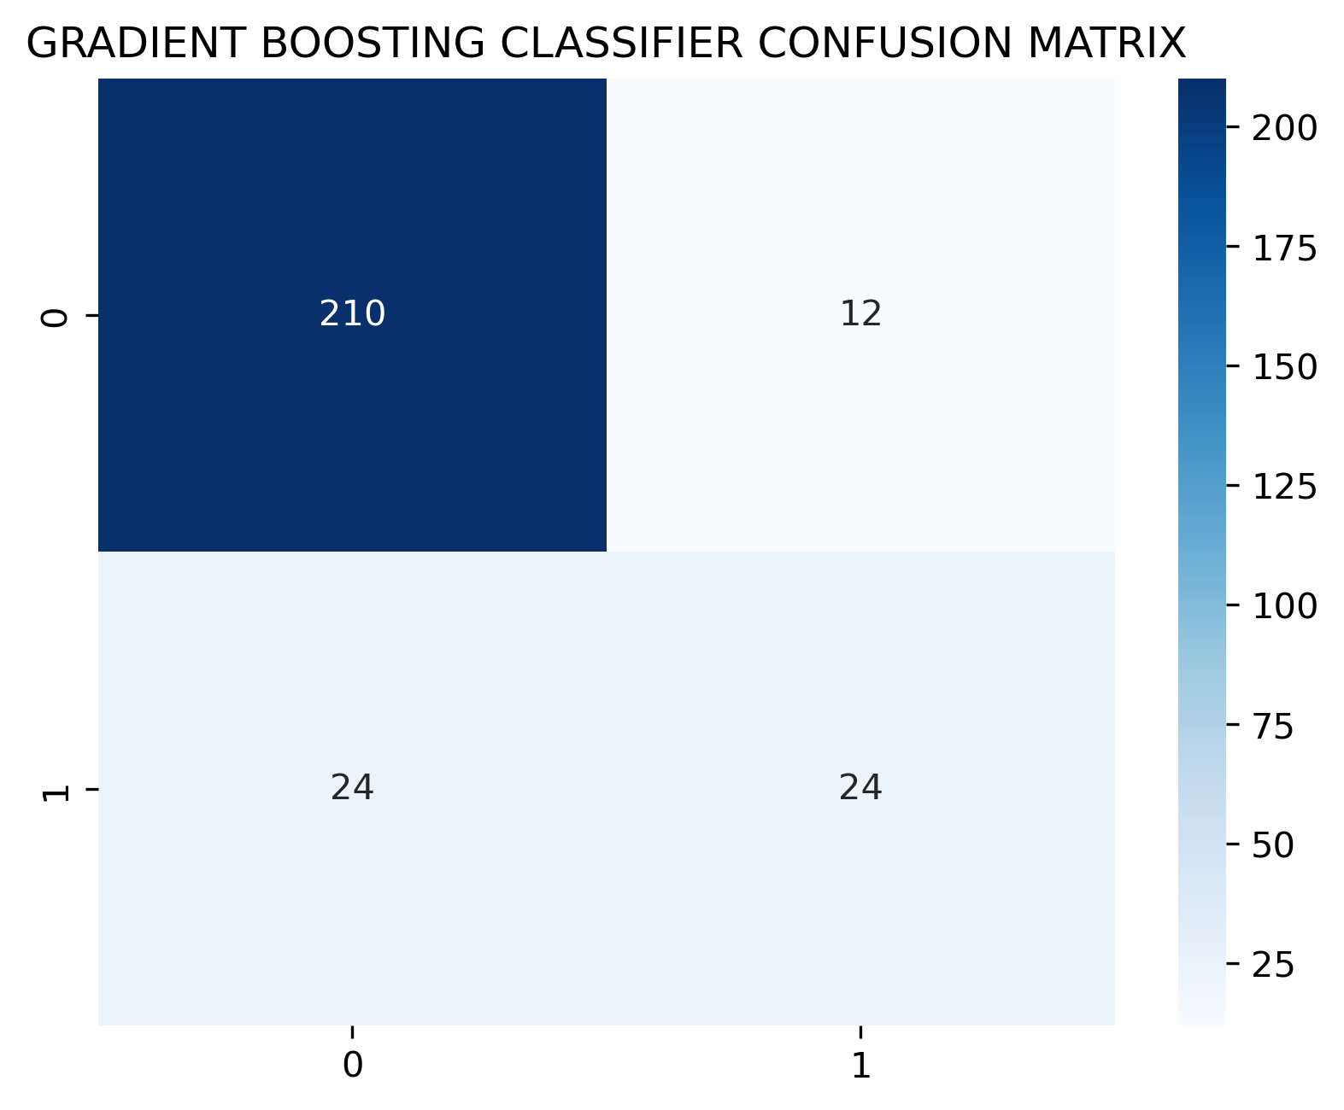
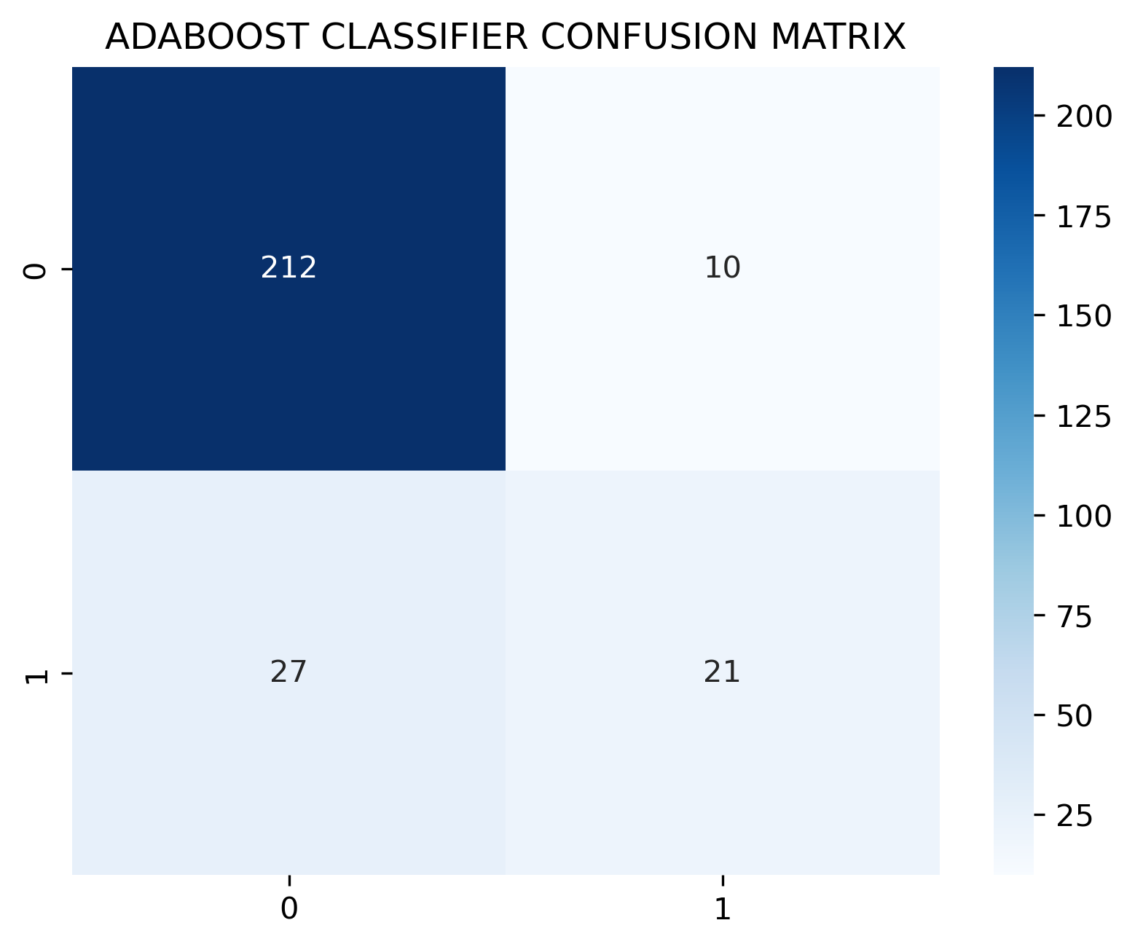
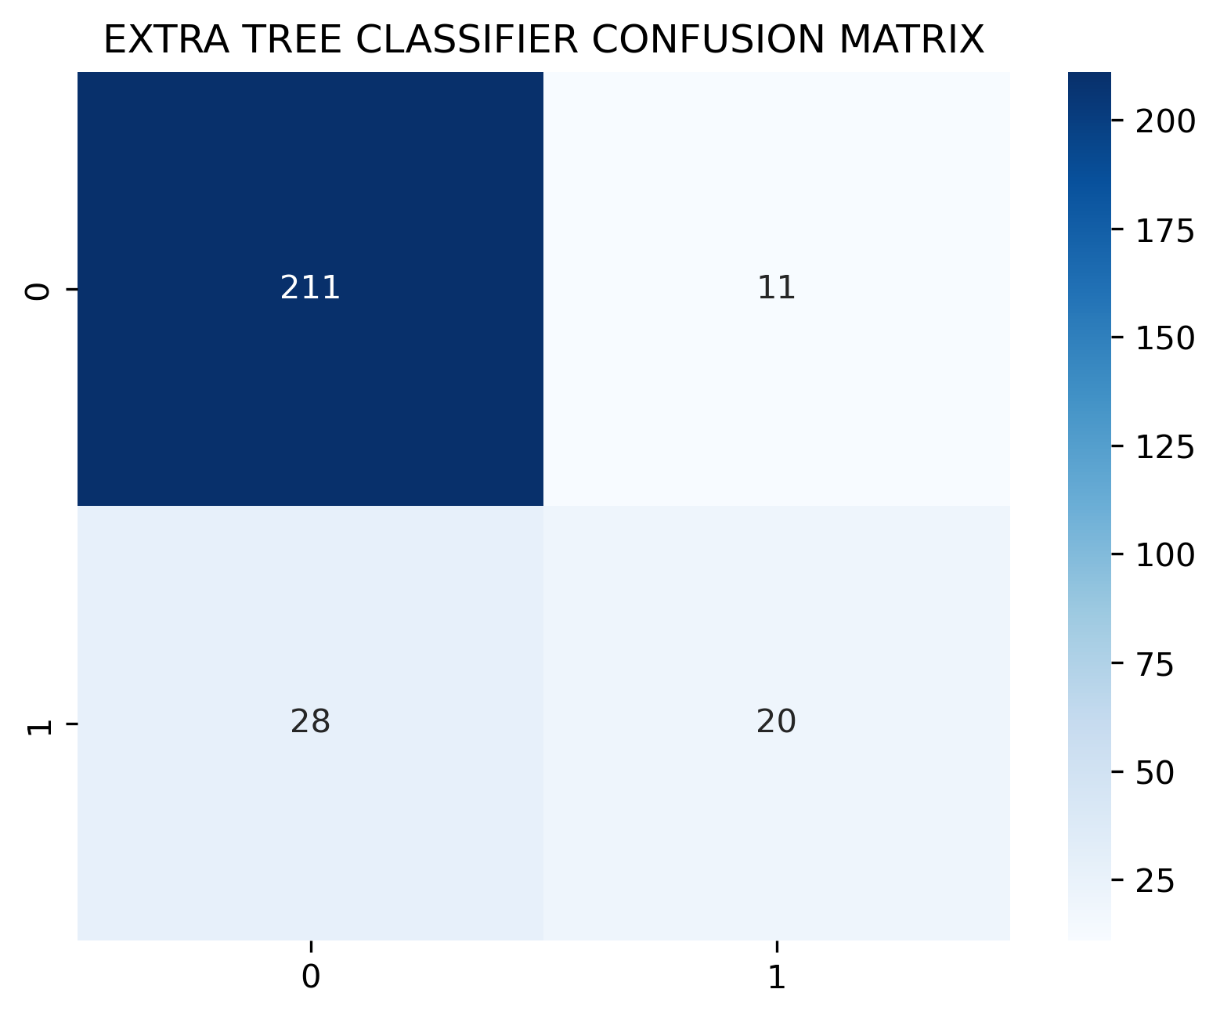
Data Exploration – Confusion Matrix
The Random Forest appears to have relatively better overall performance compared to the other algorithms.
Notes:
Tunga

Slide 11
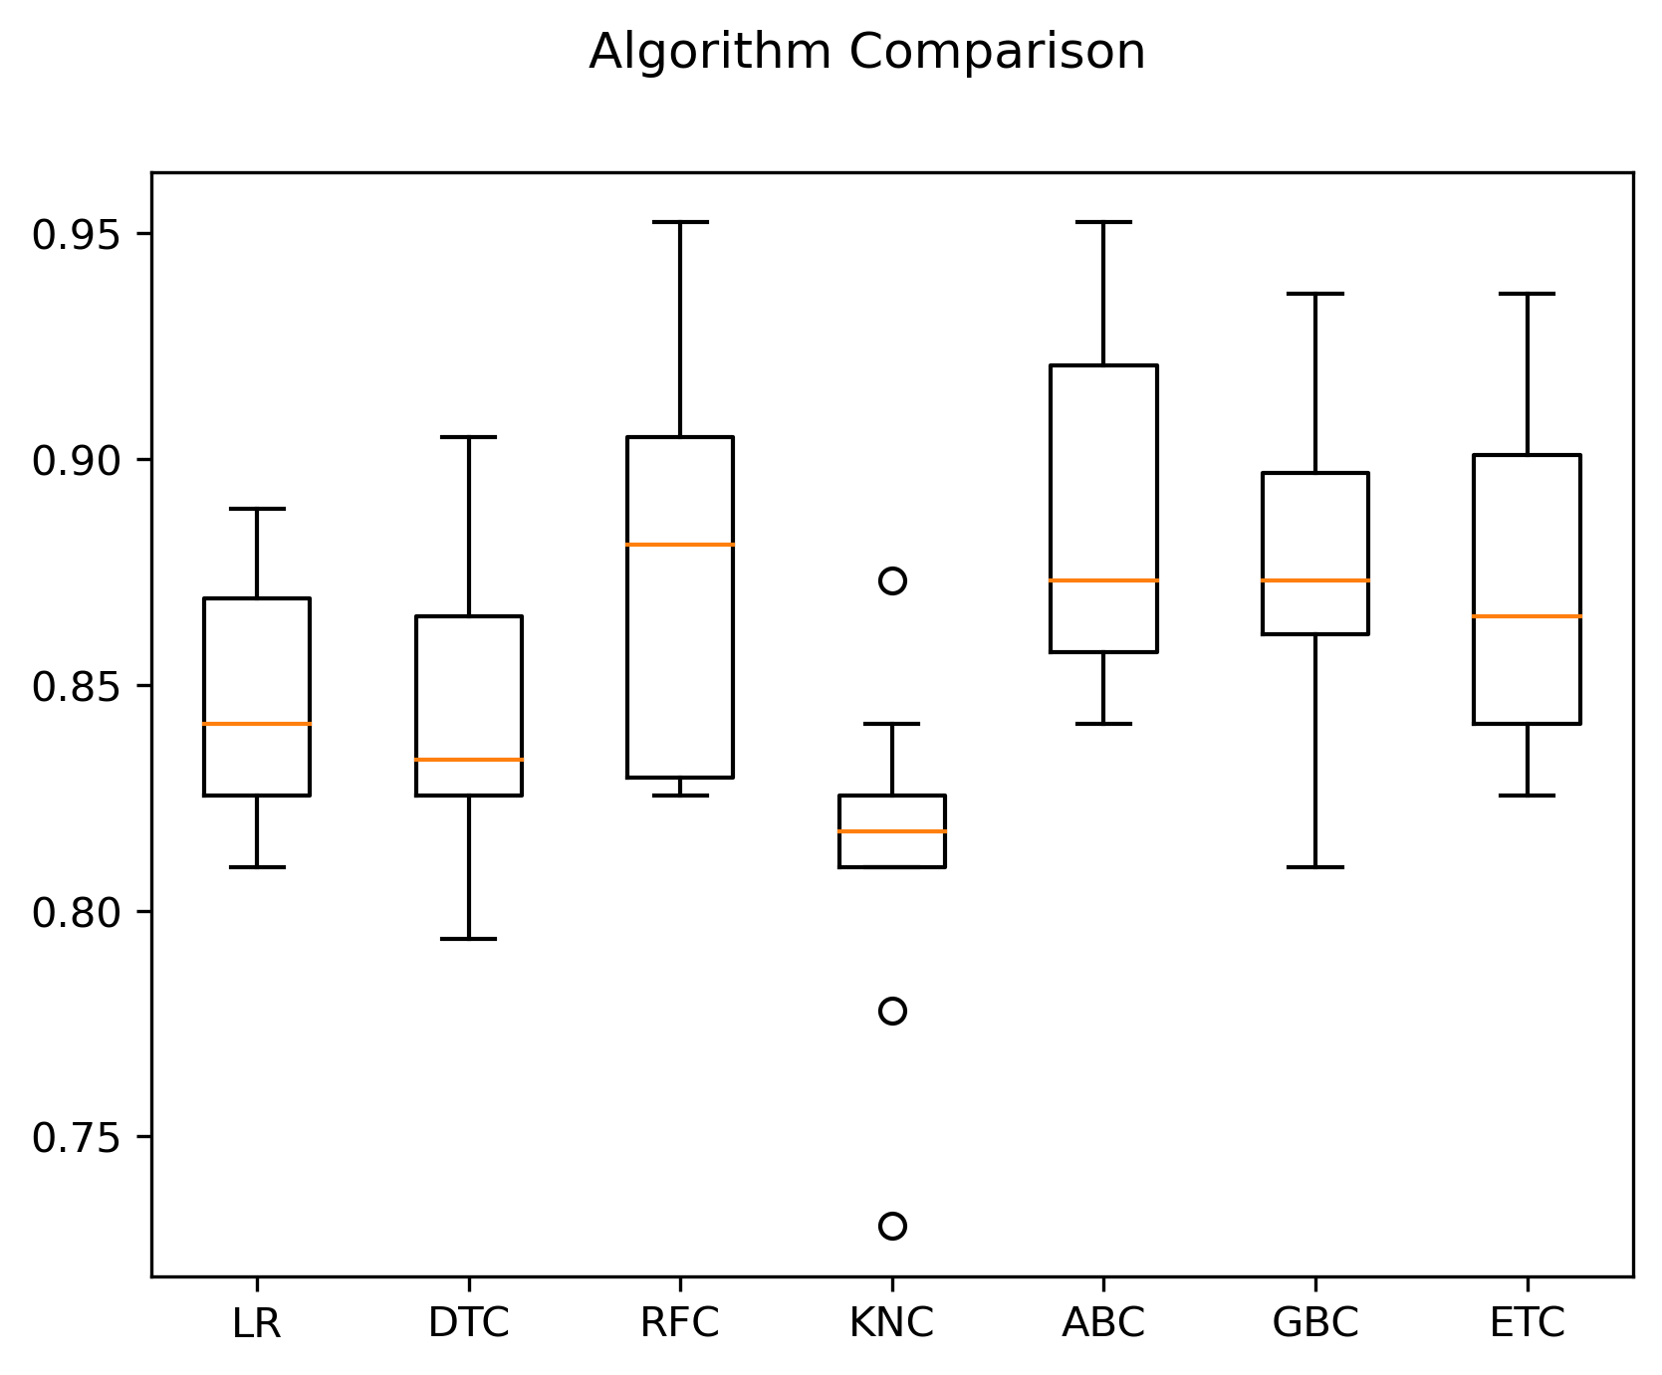
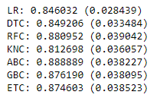
Data Exploration
Ada Boost Classifier is the best option for mean and standard deviation of the accuracy scores.

Slide 12
Neural Network – Predicting Churn
Neural Networks – Advanced form of Machine Learning known as ‘Deep Learning’
Neural Networks - Uses interconnected nodes or neurons in a layered structure that resembles the human brain.
Our Goal: Predicting Client Churn
Datafile: 900 records, 6 fields used in our model.
Target variable:
Churn
Features:
Client Age
Total Purchase
Account Manager (0/1)
Years Subscribed
Number of Websites Used
Initial construction run shows strong predictive capacity: 86%
Predictive accuracy decreased with additional layers added, increased neurons, and more powerful activation functions
The initial two layers, the sigmoid activation function for each layer, and 500 & 300 neurons respectively, increased predictive accuracy 1% : 87%
Neural Networks is most effective when used with ‘BIG data’
Neural Networks can yield unreliable results on data that is too small/simple
Potential underperformance due to:
Overfitting Training Data
The Vanishing Gradient Theorem (i.e. Back Propagation)
Notes:
Francesca

Slide 13
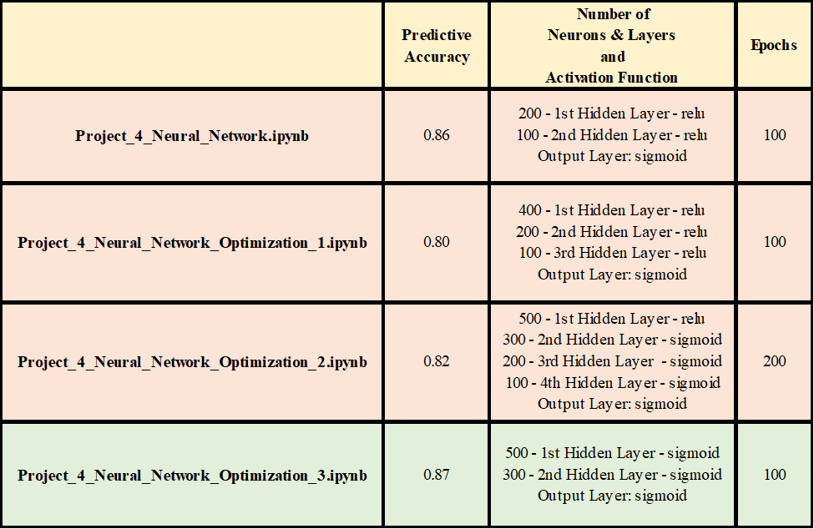
Neural Network – Predicting Churn

Slide 14
Challenges Faced
Datafile relatively small – 900 records
Only 10 fields to work with
Geographic data completely fictional

Slide 15


